Slide 1

Final Project
Hospital Management System
Group 14:
K.Bindu Sravya(16246180)
Y.Anusha(16271202)
K.Bhavana Deepthi(16275870)

Slide 2
Features of the project.
Hospital management system is an automated software for all the hospital needs.
It is to record each and every transaction of the hospital and preserve securely.
It is the paperless office and transmit the data with in the departments.

Slide 3
Main Modules
ER Diagram
Database Schema Diagram
Constraints
Functional Requirements
Front End Design
Inpatient form Details
Billing details
Patient Discharge Info
Doctor Entry
New User
Room Information

Slide 4
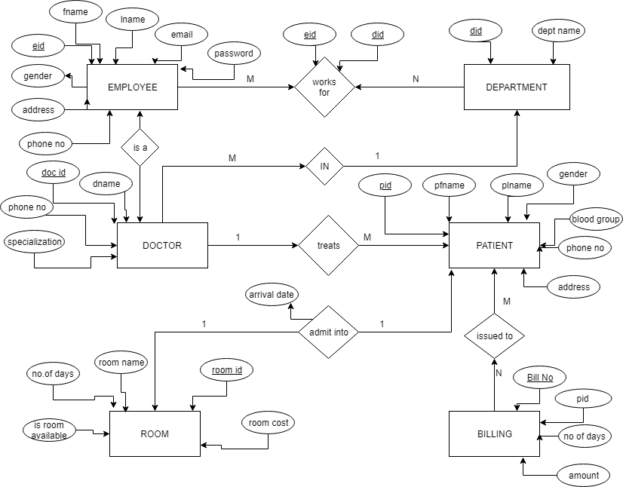
ER-Diagram

Slide 5
This model is a sort of flowchart that represents how "substances, for example, individuals, articles or ideas identify with one another inside a framework.
This diagram gives the brief explanation about the project and the entities that are used in each module.
We used several entity categories to distinguish the diagram.

Slide 6
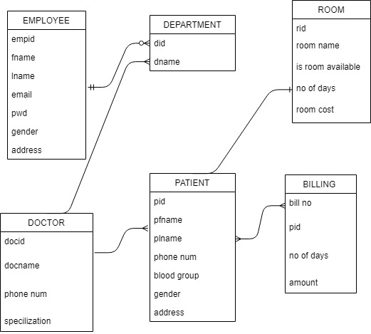
Database Schema Diagram

Slide 7
Constraints
Date of joining cannot be less than 2010
Date of birth of both employee and patient cannot be less than 1900
The username, password, department name, qualification, age, gender etc cannot be null.
There is a “IS Room” field , if there is a room allocated to some body then the value becomes 1 implying that it is not free , when the patient leaves the value is set to 0 implying it is free that is why there is a 1-1 relationship between patient and room.

Slide 8
Functional Requirements:
Admin logins, can add new doctor, Patient and can also delete them or update them.
Employee can login using his/her ID, can view the information about the patients.
After we admit patient into room and then discharging them we can generate a bill to them with all the details like admission date, discharge date, bill no, total amount, service charge.

Slide 9
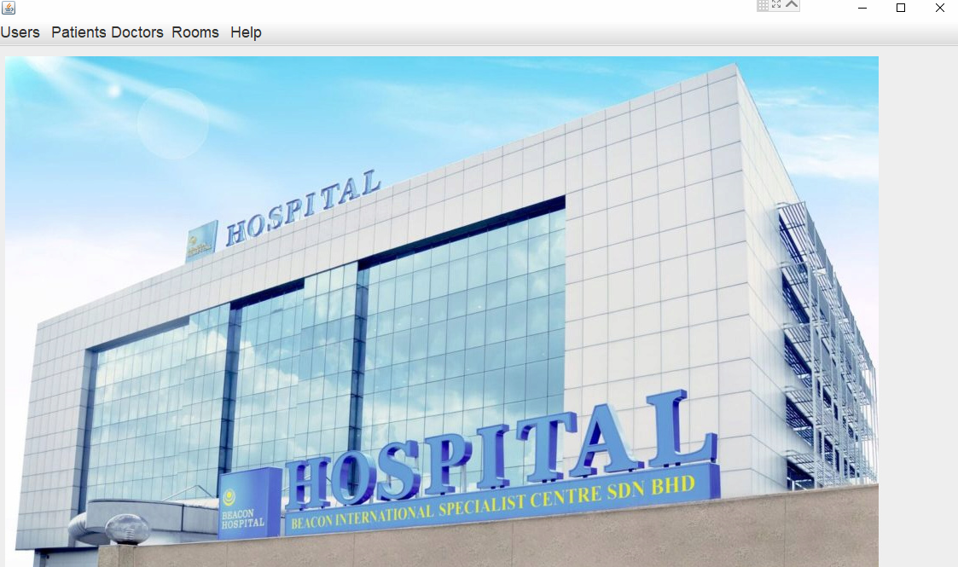
Front End Design

Slide 10
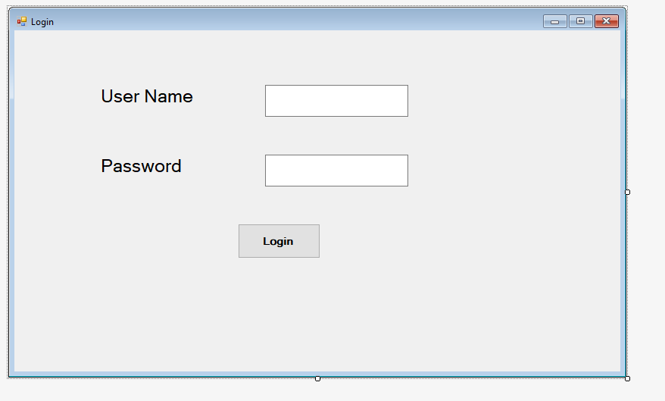
Login screen

Slide 11
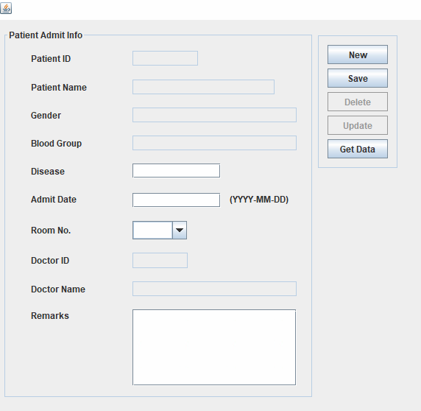
Inpatient form

Slide 12
The inpatient details should be filled by the receptionist to enter all the details of the patient.
According to the details of the patient all the information of that particular patient will be stored in the hospital database.
The patient will be allotted to a particular doctor regarding the details he/she gives while filling the form.
If any of the details about the patient should be added or removed those details can be edited.

Slide 13
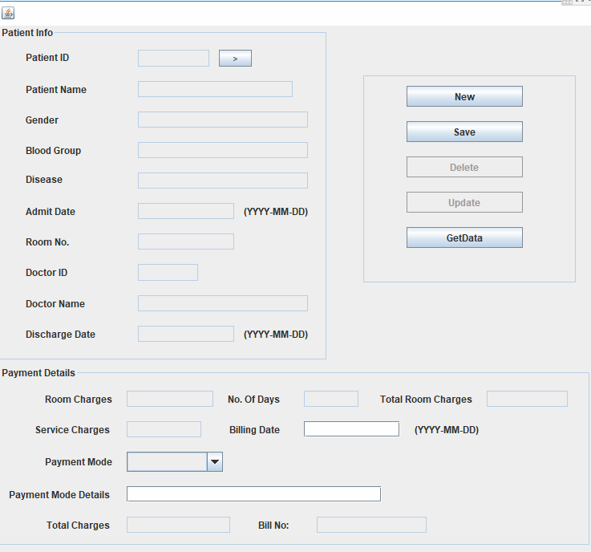
Billing details

Slide 14
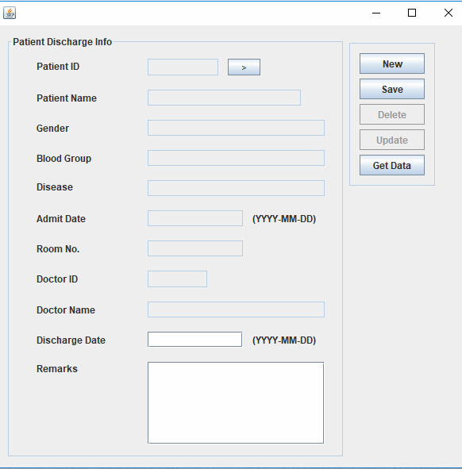
Patient Discharge Info

Slide 15
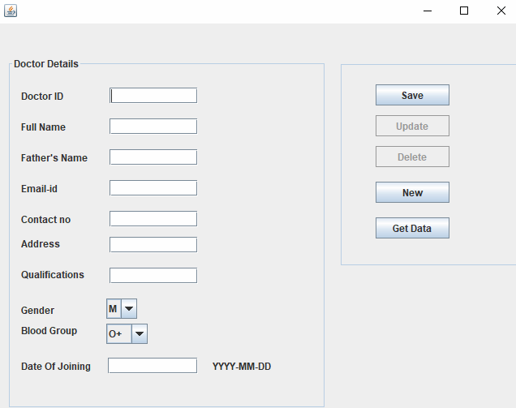
Doctor Entry

Slide 16
Can enter the new doctor details.
Details such as name, specialization, email address etc are entered while saving the new doctor details.
Can update and delete the records after once they are entered .

Slide 17
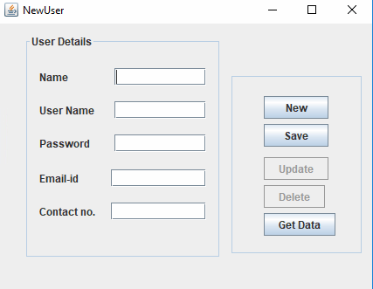
New user

Slide 18
The patient who is admitting for the first time in the hospital has to fill the form
Near the reception.
The employee with the login credentials will have access to perform any operation.

Slide 19
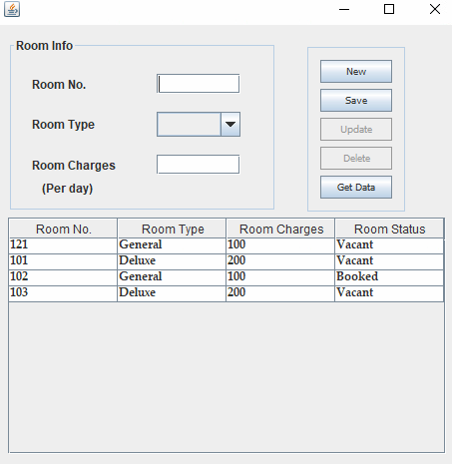
Room Information

Slide 20
Room information is used to give information about what rooms are available and to enter the new room details.
Charges to the specific room also can be entered according to the room type.

Slide 21
Code:
The scripts to the java front end code and back end can be found in the below github link:
https://github.com/bindukarumuru27/hp_management-group14

Slide 22
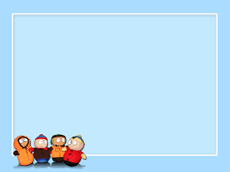
Thank You

